Slide 1
Concepts of Database Management
Seventh Edition
Chapter 1
Introduction to Database Management

Slide 2
Objectives
Differentiate Data from Information
Introduce the Hierarchy of Data
Differentiate Flat File vs Relational database
Introduce TAL Distributors, the company that is used as the basis for many of the examples throughout the text
Describe database management systems (DBMSs)
Explain the advantages and disadvantages of database processing

Slide 3
Objectives (continued)
Introduce Colonial Adventure Tours, the company that is used in a case that appears throughout the text
Introduce Solmaris CondominiumGroup, the company that is used in another case that appears throughout the text

Slide 4
Database in our everyday lives.
Imagine yourself early in the morning last enrollment day this semester and going to the school for such enrollment. But, before going to the school your mother has an errand for you to buy cash power at PUC because according to her your cash power would only last until that day. So you bought a cash power from PUC. After that you go straight to the school for the enrollment. After scrambling for the best schedules for you and available seats for your desired courses, you finally got a list of courses for this semester. You go straight to OAR for the final enrollment of your listed courses.

Slide 5
Database in our everyday lives
After that you relax a little bit by going to the library to use the Internet and then logging-in to your favorite website www.facebook.com to check out for any updates from your friends. Then you remember that it is the birthday on one of your close friend, so you have to call her but you run out of phone load. So, you rushed into a nearby store and bought a pre-paid card. Then, loaded the pre-paid card information to your phone. Now, you could call your friend to greet her a happy birthday!
- All of the major activities above involve the use of a Database, the data involved in buying cash power, logging-in to facebook and loading prepaid card information and many, many more others.

Slide 6
Definition of Database
So, you may ask what is a Database ?
A database is a collection of data organized in a manner that allows access, retrieval and updating of such data.

Slide 7
Definition of Data
And what is Data ?
Data are raw and unprocessed facts.
For example your ID Number, First Name, Last Name, Address, your recent photo are actually examples of Data.
Data by itself has no meaning or has no sense. For example if you are given a series of facts like 960 2013/1 Main, you may ask what’s that?
Or let’s say I get all your ages in this class and put it in an MS Excel file by itself has no meaning and considered Data.

Slide 8
Definition of Information
Information on the other hand are data that have been organized, processed and manipulated is such a manner that has coherence, meaning to the intended user. It is an interpreted data that would be useful to the intended user.
For example the series of facts that I mentioned awhile ago, namely : 960 2013/1 Main actually is enrollment statistic for this Semester, that is, there are 960 Enrollees for Spring 2013 semester at National or Main campus.
Or the ages that I collected from this class if a sum all of it and divide it with the number of students we have in this class then I would come up with the average age of this class and that is information because I applied a process (or manipulated it, not in the wrong sense of course) that would result into a form that would be meaningful to me, in this case I want to know the average of my class.

Slide 9
Hierarchy of Data
Database
Table
Record
Field

Slide 10
Hierarchy of Data - Field
A field is a basic fact or the most basic data element. For example your name, phone number, address, program, gender are example of fields. Another names for a field is column or attributes.
Database
Table
Record
Field

Slide 11
Example - Field
ID | Lastname | Firstname | Gender | Program | Email
101 | Smith | George | M | CIS | g.smith@yahoo.com
102 | Moore | Jane | F | HCOP | j.moore@yahoo.com
103 | Ifamilik | John | M | Education | i.john@yahoo.com
All the columns are Fields
ID, Lastname, Firstname, Gender, Program & Email are Field Names
101, Moore, HCOP, Education, John etc are examples of
Field Values.
Note : Do not confuse the Field Names with its actual Field Values. This is
the most common mistake for first timers in Database. The Field Names are
labels while the Field values is the actual content of the Field Name.

Slide 12
Hierarchy of Data - Record
A record is a collection of related fields. Another names for a record is row and tuple.
Database
Table
Record
Field

Slide 13
Example - Record
ID | Lastname | Firstname | Gender | Program | Email
101 | Smith | George | M | CIS | g.smith@yahoo.com
102 | Moore | Jane | F | HCOP | j.moore@yahoo.com
103 | Ifamilik | John | M | Education | i.john@yahoo.com
Every Row (except the heading) on the top Figure is a Record
There are three (3) Records on this instance

Slide 14
Hierarchy of Data - Table
A table is a collection of related records. Another name for a record is a File.
Database
Table
Record
Field

Slide 15
Example - Table
ID | Lastname | Firstname | Gender | Program | Email
101 | Smith | George | M | CIS | g.smith@yahoo.com
102 | Moore | Jane | F | HCOP | j.moore@yahoo.com
103 | Ifamilik | John | M | Education | i.john@yahoo.com
The whole thing on the above figure is a Table
In this case we have a Student table here
A Table actually is a collection of related records

Slide 16
Hierarchy of Data - Database
A Database according to earlier definition is a collection of data organized in a manner that allows access, retrieval and updating of such data.
It is actually a collection of related Table
Database
Table
Record
Field

Slide 17
Example - Database
ID | Lastname | Firstname | Gender | Program | Email
101 | Smith | George | M | CIS | g.smith@yahoo.com
102 | Moore | Jane | F | HCOP | j.moore@yahoo.com
103 | Ifamilik | John | M | Education | i.john@yahoo.com
CoursesTakenID | ID | CourseNumber | Section
2012-1 | 101 | IS240 | 1
2012-2 | 101 | IS230 | 1
2012-3 | 102 | IS260 | 1
2012-4 | 103 | CA100 | 5
There are two tables here one is the Students table and other is the
Courses Taken table

Slide 18
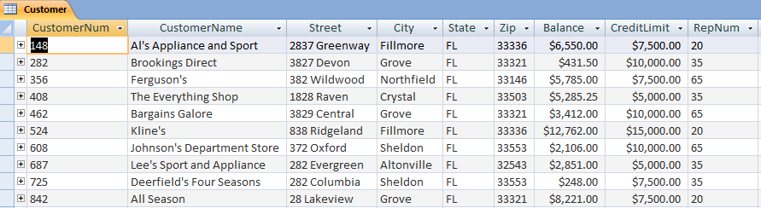
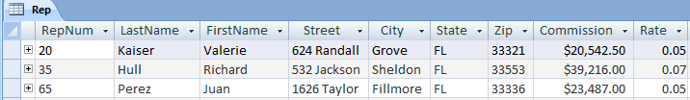
Example of an Actual Database

Slide 19
Graded Exercise No. 1 – SLO No. 2
Identify what are the Tables in your assigned database and what are the fields on each Table.
Example Output:
Tables : Student, Program
Fields :
  Student : StudentID, Lastname, Firstname
  Program : ProgramID, ProgramName, Chair
Set A – Colonial Adventure Tours (Pages 16-21)
Set B – Solmaris Condominium Group (Pages 21-24)

Slide 20
Flat File
A Flat File is a file that has no structure of relationship with another file,
that’s why it is called a ‘Flat’ file in the first place. A good example would
be a spreadsheet file like MS Excel, or a simple text file like a CSV (Comma
Separated Values) file and many more others that could not create a
structure of relationship with other similar file.
Problem with Flat files are redundancy or needless duplication of data, security, that is, no integral security that would allow access or at least limit
some users from accessing some important or sensitive data. It also has problem of relating two files or more because it has no structure for such. And finally it has size limitation, that is, it could not grow as much you want it to be in terms of bytes or data that you want to store.

Slide 21
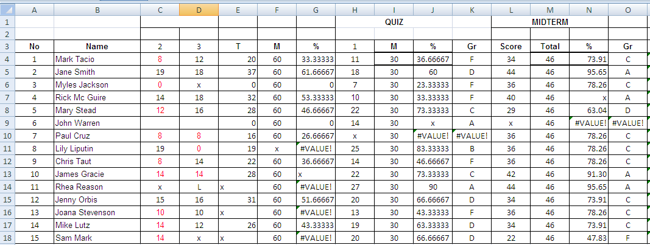
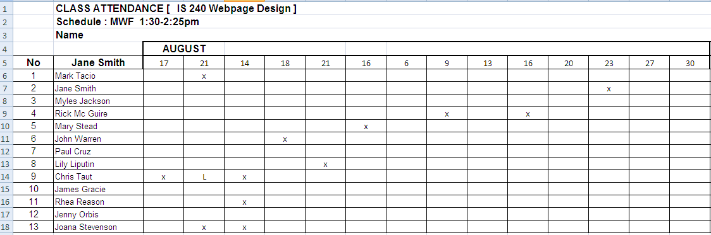
Flat File – Example (Spreadsheet)
Grades
No relationship
Attendance
You could not easily relate the two Spreadsheet (or Flat) Files

Slide 22
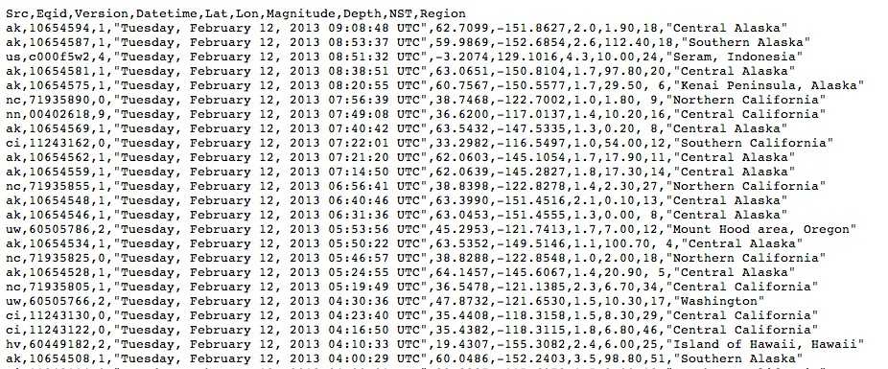
Flat File Example (Text File)
A Comma Separated Value (CSV) Text file

Slide 23
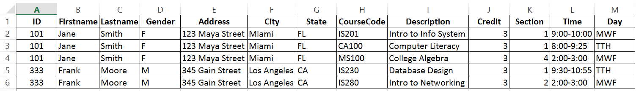
Flat File - Example
Courses Taken by Student
Redundant Data
Flat file like this Spreadsheet could result in redundancy

Slide 24
Relational Database
On the other hand a Relational Database is a concept that does not
only follow the hierarchy of data (i.e. Field, Record, Table and Database) data structure but also has a structure that would allow the creation of relationship among its files (i.e. Tables). For example if have a table named Authors
and also a table named Books, using the relational database concept I could
create for example a relationship between the two tables, namely, an Author could write one or more Books.
Author
AuthorCode
Lastname
Firstname
Gender
Nationality
Books
BookCode
BookTitle
Genre
AuthorCode
Price

Slide 25
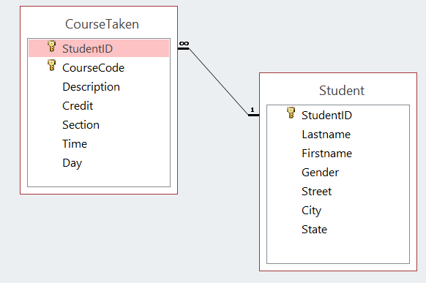
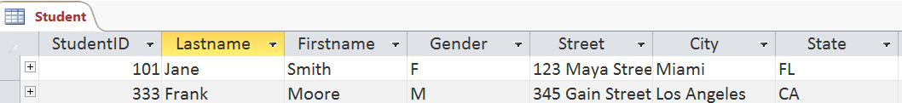
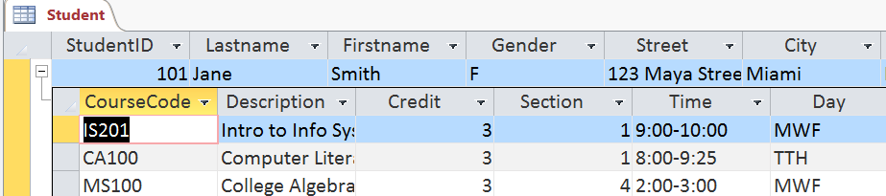
Flat File vs Relational
Courses Taken by Student (Flat File)
Relational Database in MS Access
No Redundancy
Relational database has no redundancy

Slide 26



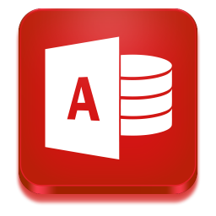

Relational Database Management System
A Relational Database Management System or RDBMS is a software that
allows the user like you to create, connect, manage and update your Database according to your needs. Popular RDMBS software are Oracle, DB2, mySQL, MS SQL Server and MS Access to name a few.

Slide 27
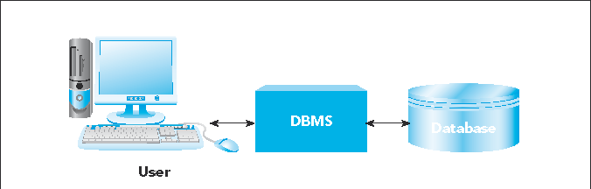
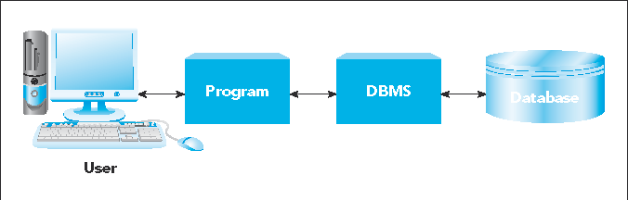
Relational Database Management System
FIGURE 1-8: Using a DBMS directly
FIGURE 1-9: Using a DBMS through another program

Slide 28

MS Access Demo

Slide 29
Graded Exercise No. 2 – SLO No. 1
Convert any two tables in your assigned Case Study database into a flat file using Spreadsheet file (See Slides 21,23 & 25 as examples) or as one main table as Text File (See Slides 22 as example)
Set A – Colonial Adventure Tours
Set B – Solmaris Condominium Group
Name your file FlatFile-YourLastname.xlsx (if MS Excel) or FlatFile-YourLastname.csv (if CSV using Notepad)
Send to nationalcis@gmail.com
Title of your email : IS230 Exercise No. 2 on Flat File

Slide 30
Database Case Studies intro
In this class we are going to use two of popular RDBMS software, namely,
MS Access and mySQL. In fact we have three Case Study databases that
we are going to explore in this class, namely, TAL Distributors, Colonial Adventure Tours and Solmaris Condominium Group.
  TAL Distributors – Wholesaler of wooden toys, games and puzzles that uses MS Excel as their mode of storing information but has recently converted it to a Relational Database model of storage.
  Colonial Adventure Tours – is a small business that organizes day-long guided trips to New England.
Solmaris Condominium Group – manages condominium complexes located in Florida on two locations, namely, Solmaris Ocean and Solmaris Bayside.

Slide 31
TAL Distributors Background
TAL Distributors
  Wholesaler of wooden toys, games, puzzles
  Uses spreadsheet software to maintain important data
  Recent growth has made spreadsheet approach problematic

Slide 32
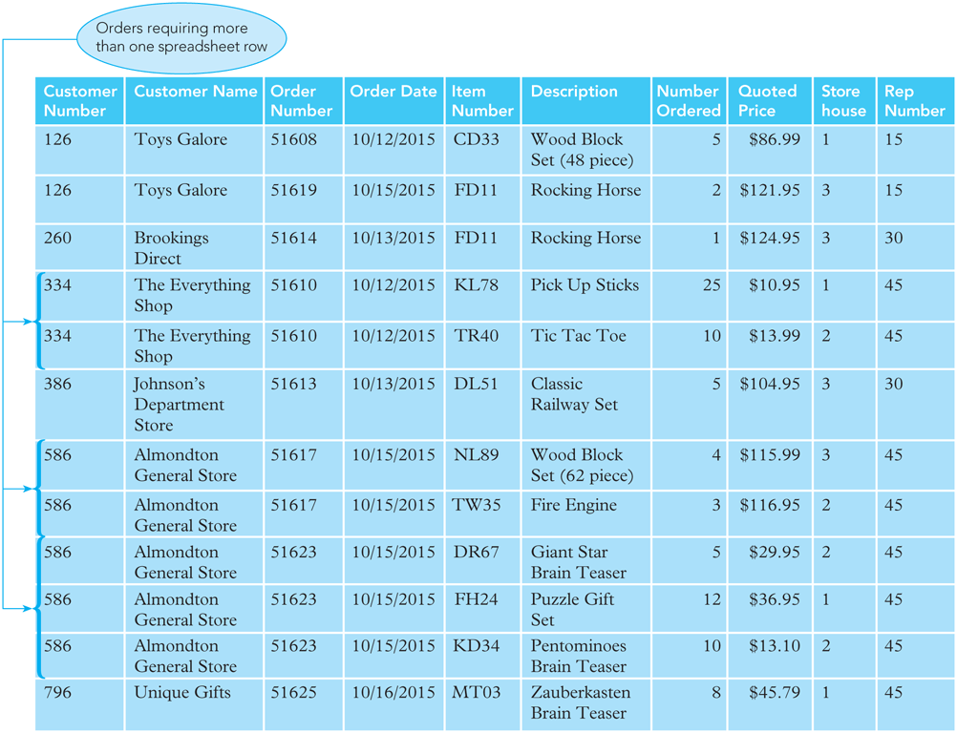
TAL Distributors Background (continued)
FIGURE 1-1: Sample orders spreadsheet

Slide 33
TAL Distributors Background (continued)
Problems using spreadsheet
  Redundancy
    Duplication of data or the storing of the same data in more than one place
  Difficulty accessing related data
  Limited security
  Size limitations

Slide 34
TAL Distributors Background (continued)
Information TAL Distributors needs to maintain
  Sales Reps
    Sales rep number, last name, first name, address, total commission, commission rate
  Customers
    Customer number, name, address, current balance, credit limit, number of customer’s sales rep
  Items Inventory
    Item number, description, number units on hand, item category, storehouse number, unit price

Slide 35
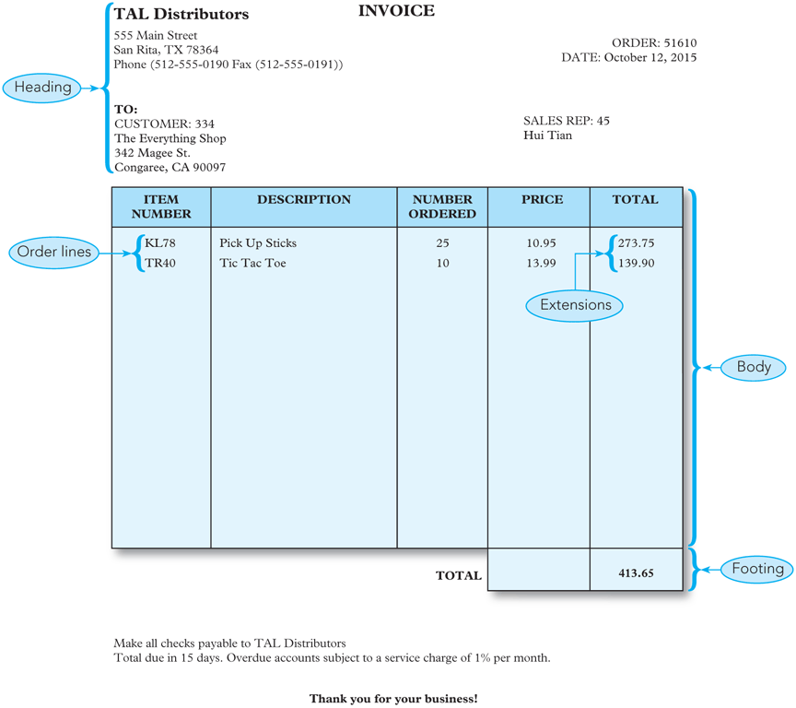
TAL Distributors Background (continued)
FIGURE 1-2: Sample order

Slide 36
TAL Distributors Background (continued)
Items for each customer’s order
  Order
    Order number, order date, customer number
  Order line
    Order number, item number, number of units ordered, quoted price
  Overall order total
    Not stored because it can be calculated

Slide 37
Database Background
Database
  Structure that can store information about:
    Different categories of information
    Relationships between those categories of information
Entity
  Person, place, object, event, or idea
  Entities for TAL Distributors: sales reps, customers, orders, and items

Slide 38




Database Background
Entity or Category could be a :
Person
(ex. Teacher, Student, Physician)
Place
(ex. School, Hotel, Bank )
Object
(ex. Mouse, Books, Software )
Event
(ex. Enroll, Withdraw, Order )
Idea or Concept
(ex. Courses, Account, Delivery )

Slide 39



Database Background
Entity for Premier Products
Sales Rep
(an example for Person entity)
Customers
(an example for Person entity)
Orders
(an example for Concept or Idea entity )
Parts
(an example of Object entity )

Slide 40
Database Background (continued)
An entity has an Attribute
  Characteristic or property of an entity
  Example: Customer has name, street, city, etc.
  May also be called a field or column
An entity could have a Relationship
  Association between entities
    Three types – One-to-one, One-to-many, Many-to-many
  One-to-many relationship
    Each rep is associated with many customers
    Each customer is associated with a single rep

Slide 41
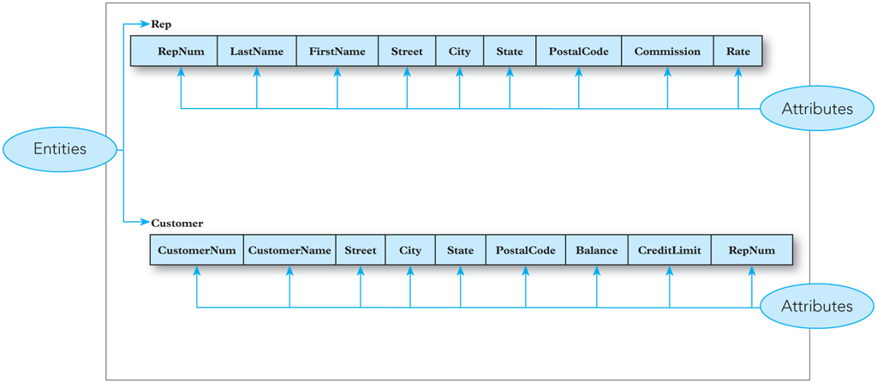
Database Background (continued)
FIGURE 1-3: Entities and attributes

Slide 42
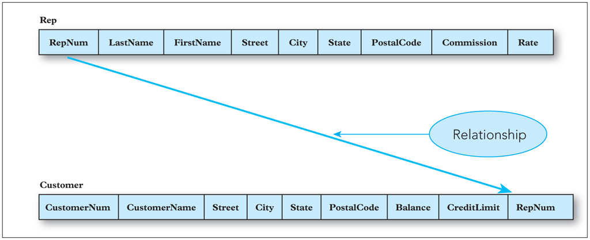
Database Background (continued)
FIGURE 1-4: One-to-many relationship

Slide 43
Database Background (continued)
Data file
  File used to store data
  Computer counterpart to ordinary paper file
Database
  Structure that can store information about:
    Multiple types of entities
    Attributes of those entities
    Relationships between the entities

Slide 44
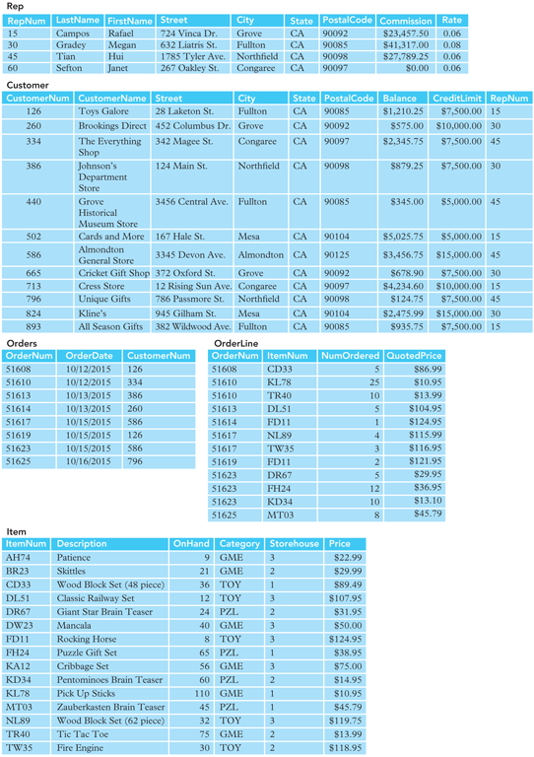
Database Background (continued)
FIGURE 1-5: Sample data TAL Distributors

Slide 45
Database Background (continued)
FIGURE 1-5: Sample data for TAL Distributors (continued)

Slide 46
Database Background (continued)
FIGURE 1-5: Sample data for TAL Distributors (continued)

Slide 47
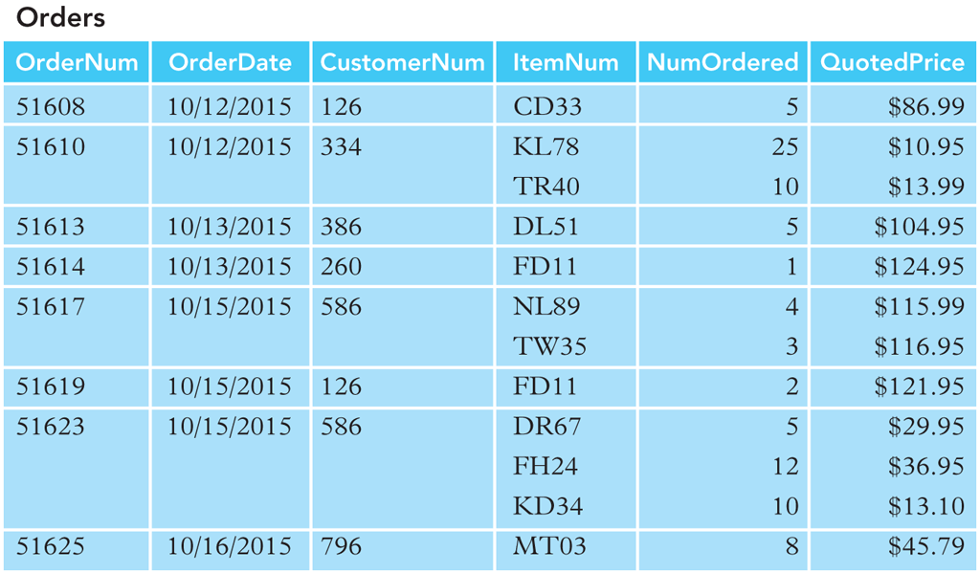
Database Background (continued)
FIGURE 1-6: Alternative Orders table structure

Slide 48
Database Background (continued)
Entity-relationship (E-R) diagram
  Visual way to represent a database
  Rectangles represent entities
  Lines represent relationships between connected entities

Slide 49
Database Background (continued)
Rep
Repnum Lastname Firstname Street State City PostalCode Commission Rate
Customer
Customernum Customername Street State City PostalCode Balance CreditLimit Repnum
Orders
Ordernum OrderDate Customernum
Relationship
Item
Itemnum Description OnHand Category Storehouse Price
Entity Name
Orderline
Ordernum Itemnum NumOrdered QuotedPrice
Entity
Attributes
FIGURE 1-7: E-R diagram for the TAL Distributors database

Slide 50
Introduction to Colonial Adventure Tours Database Case
Colonial Adventure Tours
  Small business
  Organizes day-long guided trips of New England
Management decided to use database to gather and store information on:
  Guides
  Trips
  Customers
  Reservations

Slide 51
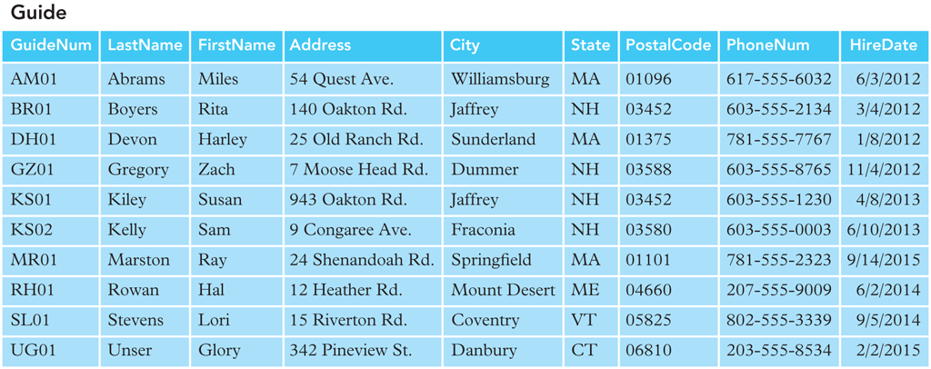
Introduction to Colonial Adventure Tours Database Case (continued)
FIGURE 1-15: Sample guide data for Colonial Adventure Tours

Slide 52
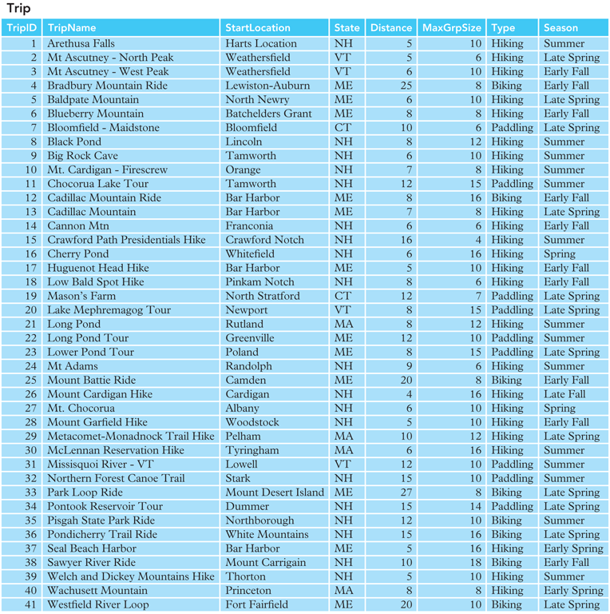
Introduction to Colonial Adventure Tours Database Case (continued)
FIGURE 1-16: Sample trip data for Colonial Adventure Tours

Slide 53
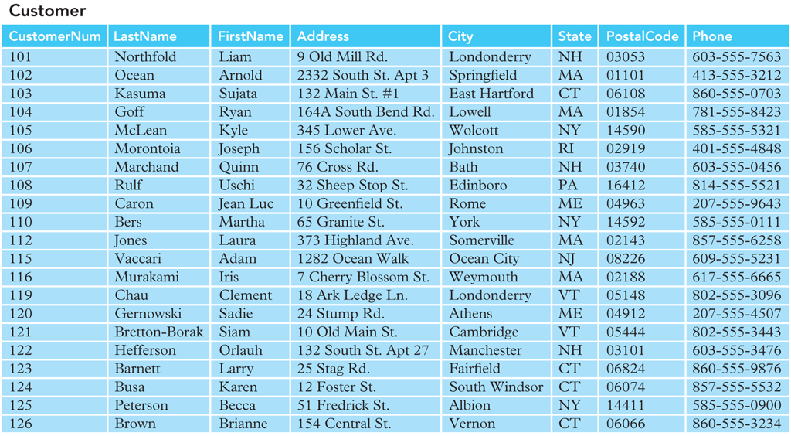
Introduction to Colonial Adventure Tours Database Case (continued)
FIGURE 1-17: Sample customer data for Colonial Adventure Tours

Slide 54
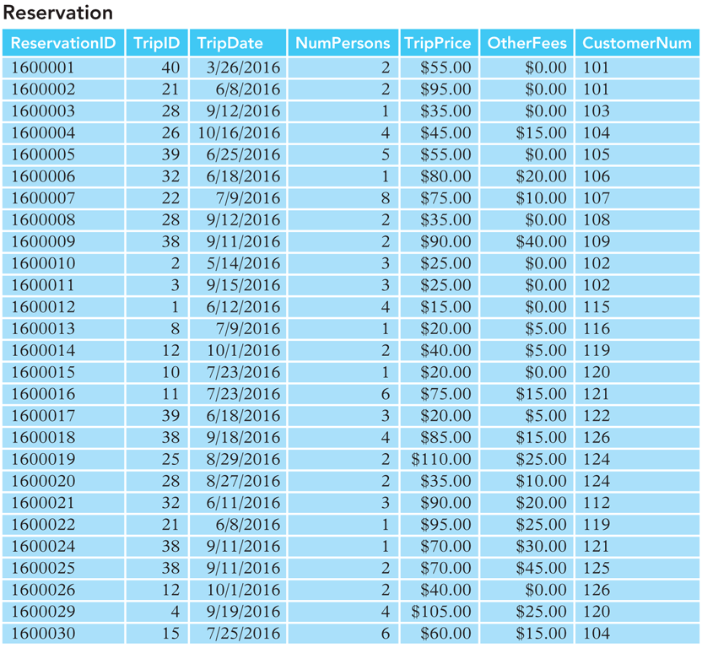
Introduction to Colonial Adventure Tours Database Case (continued)
FIGURE 1-18: Sample reservation data for Colonial Adventure Tours

Slide 55
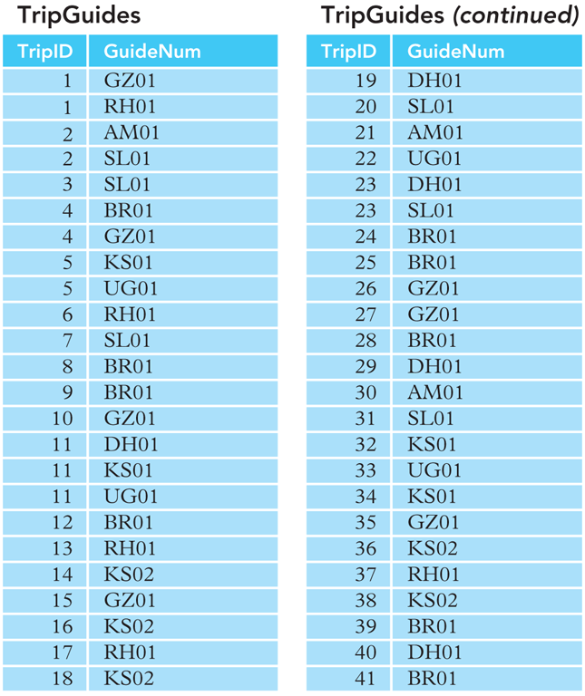
Introduction to Colonial Adventure Tours Database Case (continued)
FIGURE 1-19: Table used to relate trips and guides

Slide 56
Database Background (continued)
Customer
Customernum Lastname Firstname Street State City PostalCode Phone
Trip
TripID Tripname StartLocation State Distance MassGrpSize Type Season
Guide
Guidenum Lastname Firstname Address City State PostalCode Phonenum Hiredate
Reservation
ReservationID TripID TripDate NumPersons TripPrice OtherFees Customernum
TripGuide
TripID Guidenum
FIGURE 1-20: E-R diagram for the Colonial Adventure Tours database

Slide 57
Introduction to the Solmaris Condominium Group Database Case
Solmaris Condominium Group manages condominium complexes
  Located in Florida
  Two locations: Solmaris Ocean and Solmaris Bayside
  Maintains common areas and provides maintenance services
Database used to store data

Slide 58
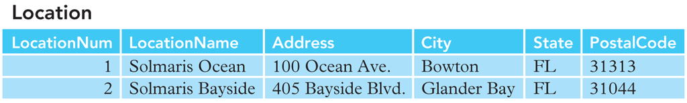
Introduction to the Solmaris Condominium Group Database Case (continued)
FIGURE 1-21: Sample location data for Solmaris Condominium Group

Slide 59
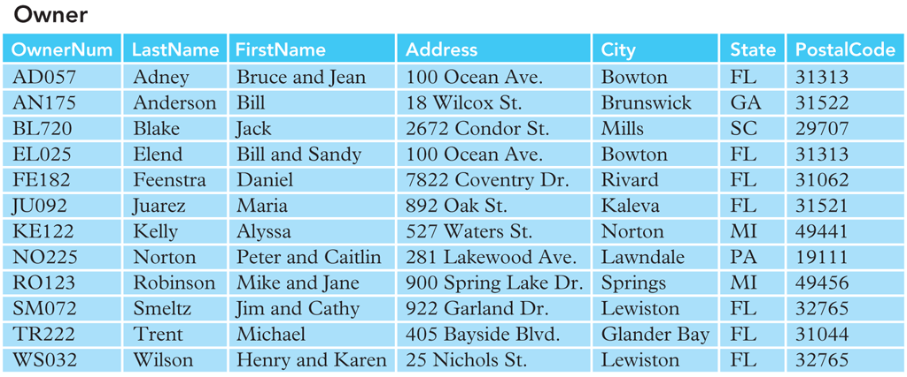
Introduction to the Solmaris Condominium Group Database Case (continued)
FIGURE 1-22: Sample owner data for Solmaris Condominium Group

Slide 60
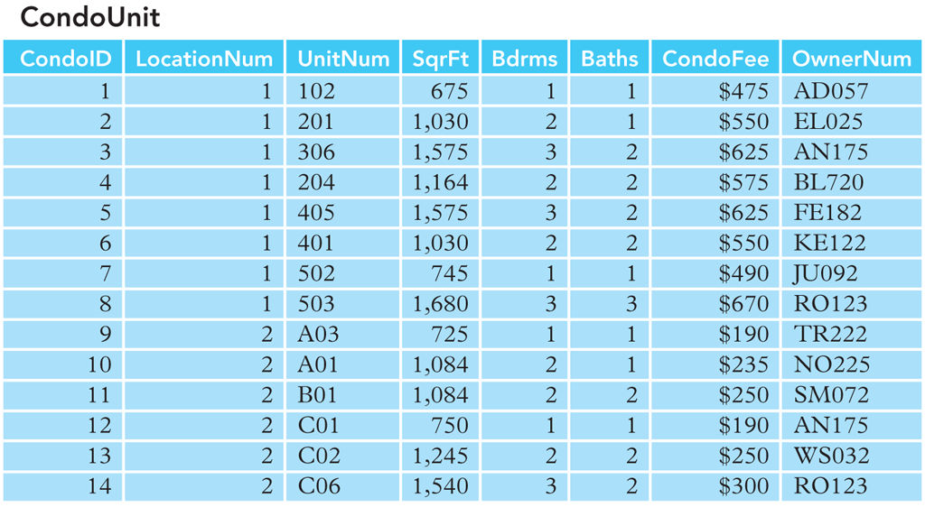
Introduction to the Solmaris Condominium Group Database Case (continued)
FIGURE 1-23: Sample data about condo units for Solmaris Condominium Group

Slide 61
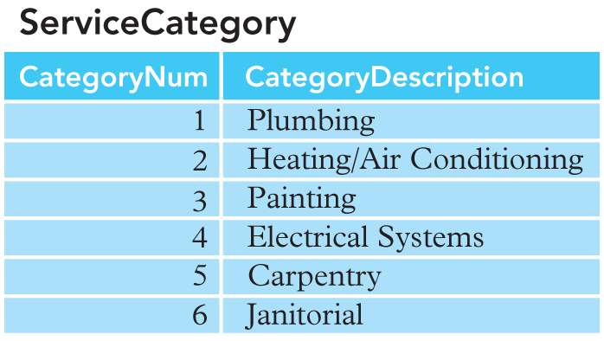
Introduction to the Solmaris Condominium Group Database Case (continued)
FIGURE 1-24: Sample data about service categories for Solmaris Condominium Group

Slide 62
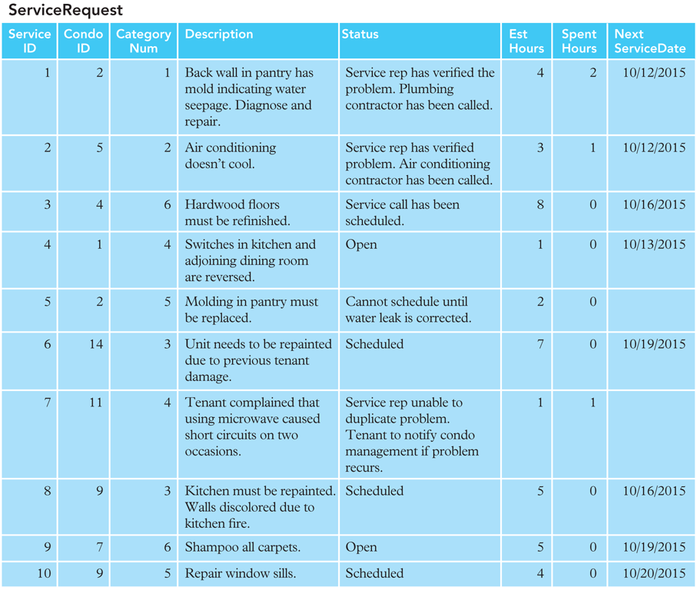
Introduction to the Solmaris Condominium Group Database Case (continued)
FIGURE 1-25: Sample data about service requests for Solmaris Condominium
Group

Slide 63
Database Background (continued)
Location
LocationNum LocationName Address Street State City PostalCode
Owner
Ownernum Lastname Firstname Address City State PostalCode
ServiceCategory
Categorynum CategoryDescription
ServiceRequest
ServiceID CondoID CategoryNum Description Status EstHours SpentHours NextServiceDate
CondoUnit
CondoID LocationNum UnitNum SqrFt BdRms Baths CondoFee Ownernum
FIGURE 1-20: E-R diagram for the Colonial Adventure Tours database

Slide 64
Summary
Problems with nondatabase approaches to data management: redundancy, difficulties accessing related data, limited security features, limited data sharing features, and potential size limitations
Entity: person, place, object, event, or idea for which you want to store and process data
Attribute, field, or column: characteristic or property of an entity
Relationship: an association between entities

Slide 65
Summary (continued)
One-to-many relationship: each occurrence of first entity is related to many occurrences of the second entity and each occurrence of the second entity is related to only one occurrence of the first entity
Database: structure that can store information about multiple types of entities, attributes of entities, and relationships among entities
TAL Distributors requires information about reps, customers, parts, orders, and order lines
Entity-relationship (E-R) diagram: represents a database visually by using various symbols

Slide 66
Summary (continued)
Database management system (DBMS): program through which users interact with a database; lets you create forms and reports quickly and easily and obtain answers to questions about the data
Advantages of database processing: getting more information from the same amount of data, sharing data, balancing conflicting requirements, controlling redundancy, facilitating consistency, improving integrity, expanding security, increasing productivity, and providing data independence

Slide 67
Summary (continued)
Disadvantages of database processing: larger file size, increased complexity, greater impact of failure, and more difficult recovery
Colonial Adventure Tours needs to store information about: guides, trips, customers, and reservations
Solmaris Condominium Group needs to store information about: condo locations, owners, condo units, service categories, and service requests

